Slide 1
Face Detection on Jetson Orin Nano
By Matthew Santorsa

Slide 2
Problem
Facial recognition
Used in face ID, auto panning cameras, autofocus systems
Dataset Used
Digiface 1M
WIDER FACE
Importance
Used widely in our modern lives, from authentication to the moments we save in our phones via photos

Slide 3
Model & Method
Model
MobileNet V2
Transfer Learning
Deployed to a Nvidia Jetson Orin Nano
Smoothing Used
Alpha Filter (Exponential Moving Average)
Quantization
None used, was not worth the loss of accuracy.

Slide 4
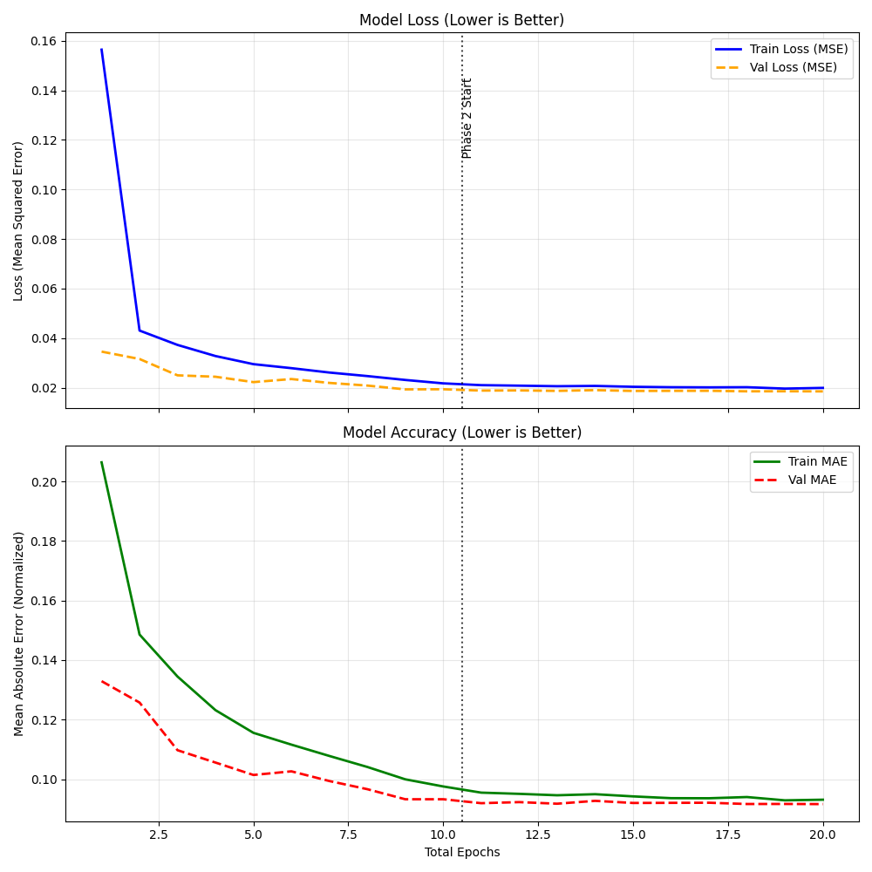
Results
Training Data
Demo Video

Slide 5
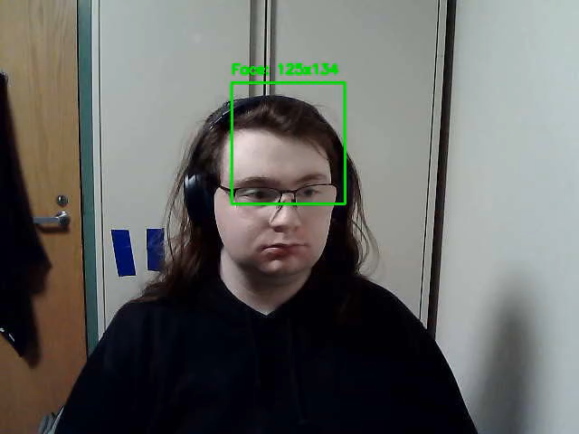
Demo Video
Some flaws
Fails to properly track to the left edge
Loves to recognize my forehead I guess?
Some highs
Runs a lot better on jetson
It actually does manage to track my face pretty well!

Slide 6
Highs & Lows
Highs
Very high accuracy, with low loss (for model)
Fairly small deployment, only about 40MB
Works with just about every camera tested
Lows
Not the best tracking out there
Model Collapse
Camera Edge Bug

Slide 7
Future Work
Debug the edge tracking
Accelerate the tracking

